Slide 2
Theory and Practice of Game Object Component Architecture
Marcin Chady
Radical Entertainment

Slide 3
Outline
Component-Oriented vs Object-Oriented Programming
Radical’s approach
Results from [PROTOTYPE]

Slide 4
What are Game Objects?
Anything that has a representation in the game world
  Characters, props, vehicles, missiles, cameras, trigger volumes, lights, etc.
Need for a standard ontology
  Clarity
  Uniformity
  Feature, staff and tool mobility
  Code reuse
  Maintenance
    E.g. use of modularity/inheritance reduces duplication
Notes:
As a rule of thumb, if it has a position it can be a game object, although not all game objects have a position.
Most games try to devise a universal representation for their objects.

Slide 5
A Game Object Class Hierarchy
GameObject
(transform, refcount)
Drawable
(renderable model)
Trigger
(volume)
Simulated
(rigid body model)
Prop
Notes:
Probably the most common way of expressing this ontology is in a semantic network, by way of OOD and inheritance. Here is an example.
It feels natural an intuitive. All game objects have a transform and a ref count perhaps. Some game objects can be drawn, other can’t. Some of those that can be drawn can also simulate. We might pause for a second there to ponder if there could be simulated objects without renderable models, but who needs simulated invisible objects?
Further down the hierarchy you will typically see something like the Prop class, used to represent all props in the game.

Slide 6
Adding Stuff
GameObject
(transform, refcount)
Drawable
(renderable model)
Trigger
(volume)
Simulated
(rigid body model)
Animated
(animation controller)
?
Animated
(animation controller)
Notes:
What if we want to add animation to the hierarchy? Some objects will only animate, while others will switch between animation and simulation.

Slide 7
Mix-ins Perhaps?
GameObject
(transform, refcount)
AnimatedMixin
(animation controller)
Drawable
(renderable model)
Trigger
(volume)
Animated
Simulated
(rigid body model)
?
AnimatedWithPhysics
Notes:
Multiple inheritance is one way of solving the problem. But it doesn’t scale well.
And it doesn’t address the ultimate challenge: a change in design/requirements, e.g. one day a designer deciding he needs a trigger volume that can be seen by the player.

Slide 8
Observations
Not every set of relationships can be described in a directed acyclic graph
Class hierarchies are hard to change
Functionality drifts upwards
Specialisations pay the memory cost of the functionality in siblings and cousins

Slide 9
Change
You can ignore it
You can resist it
Or you can embrace it
But you cannot stop it
Notes:
Some people argue that if only our industry really grew up and started planning things properly then we wouldn’t have the issues with overscoping, budget overruns, missed deadlines, tough crunch times, and the type of refactoring issues we’ve just seen. I doubt that’s possible, but suppose that you’ve somehow managed to design the perfect game upfront and planned and executed the development so that it sailed through without any hiccups. I argue that your competition can still better you by devising a system that lets them change the design half way through in response to changing market conditions and still deliver on time. Does such a system exist? I think so. I believe searching for it is a more worthwhile pursuit than trying to bet everything on perfect planning.

Slide 10
Component-Based Approach
Related to, but not the same as aspect-oriented programming
One class, a container for:
  attributes (data)
  behaviours (logic)
Attributes := list of key-value pairs
Behaviour := object with OnUpdate() and OnMessage()
Notes:
The second point is critical: we have only one class to represent all kinds of objects. Their functionality is defined by an aggregation of behaviours.
The game object class is just an empty shell. By using it, you don’t inherit any game-specific baggage. You can easily recombine existing components, but you can also replace any one of them. Most importantly, you don’t have to shoehorn any object into a definite type.
How does it work in practice?

Slide 11
Components vs Hierarchies
GameObject
GameObject
*
*
Prop
Attribute<T>
Behaviour
Notes:
Shift of ontology from a semantic network (nested sets of functionality) to flat aggregation of functionality.

Slide 12
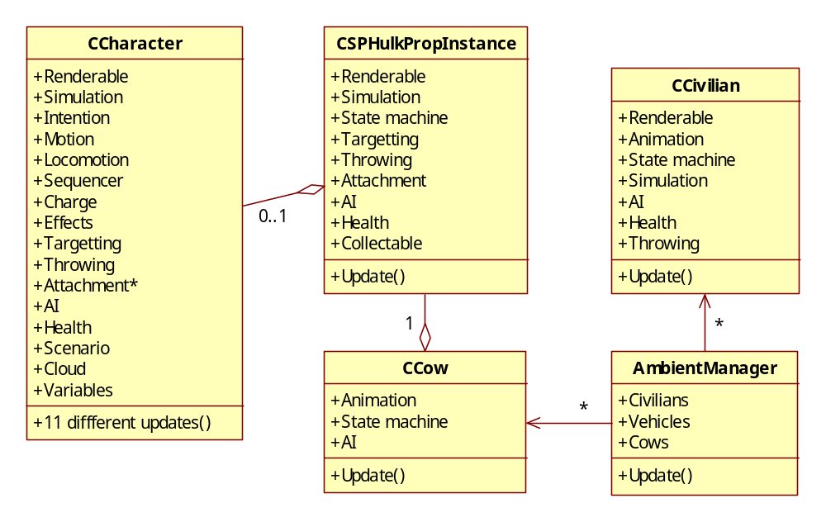
Hulk:UD Object Model
Notes:
Let’s look at an example. This is the object model from the Hulk: Ultimate Destruction game, which predates the game object model.
The two main classes are the character class and the prop class. The character class had to cater for a number of types of characters: Hulk, soldiers, Hulkbusters, boss characters etc. Therefore, it was a superset of the functionality required by all of them, e.g. it contained the AI and cloud code, which wasn’t required by Hulk. As another example, a character could be held or hold another character, prop or a civilian. These 3 cases required different code. Consequently, the file CCharacter.cpp had 11,000 lines of code and the memory footprint of a character object was over 20k. And that was on the last gen hardware.
Props were slightly lighter and had different functionality, although they replicated a lot of the code and data. When it came to implementing helicopters, it proved hard to bend either the Character class or the prop class to fit the requirements, so a hybrid was made, by creating both instances and linking one to another, the so called character props.
When it came to fleshing out the ambient system, the characters were deemed too expensive to use for pedestrians and cows. So the pedestrians were written from the ground up, and cows were implemented as animated props. Both had their own state machines and AI.

Slide 13
Prototype Game Objects
Alex
Helicopter
Pedestrian(HLOD)
Pedestrian(LLOD)
PhysicsBehaviour
TouchBehaviour
CharacterIntentionBehaviour
MotionTreeBehaviour
CollisionActionBehaviour
PuppetBehaviour
CharacterMotionBehaviour
MotionStateBehaviour
RagdollBehaviour
CharacterSolverBehaviour
HealthBehaviour
RenderBehaviour
SensesInfoBehaviour
HitReactionBehaviour
GrabSelectionBehaviour
GrabbableBehaviour
TargetableBehaviour
AudioEmitterBehaviour
FightVariablesBehaviour
ThreatReceiverBehaviour
PhysicsBehaviour
TouchBehaviour
CharacterIntentionBehaviour
MotionTreeBehaviour
CollisionActionBehaviour
PuppetBehaviour
CharacterSolverBehaviour
HealthBehaviour
RenderBehaviour
HitReactionBehaviour
GrabbableBehaviour
GrabBehavior
TargetableBehaviour
AudioEmitterBehaviour
FightVariablesBehaviour
EmotionalStateBehaviour
ThreatReceiverBehaviour
FEDisplayBehaviour
PhysicsBehaviour
CharacterIntentionBehaviour
MotionTreeBehaviour
PuppetBehaviour
HealthBehaviour
RenderBehaviour
GrabbableBehaviour
GrabBehaviour
TargetableBehaviour
AudioEmitterBehaviour
EmotionalStateBehaviour
FEDisplayBehaviour
CharacterPedBehaviour
SensesInfoBehaviour
TargetableBehaviour
PedBehaviour
Notes:
Now let’s compare it to the object model in the Prototype game. Here, all entities are instances of the same class. However, every instance is taylor-made for its specific role. It has only the behaviours it needs.
The main character doesn’t have any AI or cloud data.
The helicopter doesn’t have the character motion, ragdoll or grabbing code.
HLOD pedestrians are similar to Alex, but have fewer behaviours or use their lighter versions.
LLOD pedestrians have only three behaviours!
As you can see, instead of a rigid hierarchy of classes, onto which every new type of entity has to be more or less forcefully grafted, we have a flexible pick’n’mix approach, where every object can be made into exactly what it needs to be, without incurring much overhead.
Ground spike example.

Slide 14
Data-Driven Creation
TOD_BeginObject GameObject 1 "hotdog_concession"
{
behaviours
{
PhysicsBehaviour 1
{
physicsObject "hotdog_concession"
} ,
RenderBehaviour 1
{
drawableSource "hotdog_concession"
} ,
HealthBehaviour 1
{
health 2.000000
} ,
GrabbableBehaviour 1
{
grabbableClass "2hnd"
}
}
}
TOD_EndObject
Text or binary
Loaded from pipeline
Load and go
Delayed instancing
Dedicated tools
Data-driven inheritance
Notes:
So, is creating objects as easy as picking candy in a store? It depends on your particular implementation, but once you have a component-based framework in place, it’s relatively little effort to add a data-driven mechanism for constructing them on the fly. And that’s when productivity really takes off.
At Radical the constitution of a game object is specified in a text file, which forms part of the game content. Here is an example.
The loading system takes care of constructing the game object based on this description and placing it in the game, so it’s ready to go. Alternatively, this definition can be loaded in as a cached, reusable template. This feature is heavily used by the prop spawning system.
We have dedicated tools for run-time and batch editing of game object definitions.
Last, but not least, we have a form of inheritance supported by the loading system. It is possible to create new types of objects by concatenating the behaviours and attributes from two or more existing types. Inheritance remains a useful tool, as it helps reduce duplication.

Slide 15
Advantages
Endowing with new properties is easy
Creating new types of entities is easy
Behaviours are portable and reusable
Code that talks to game objects is type-agnostic
Everything is packaged and designed to talk to each other
In short: you can write generic code
Notes:
So clearly, there are some advantages to the component-based approach.

Slide 16
Disadvantages
In short: you have to write generic code
Game objects are typeless and opaque
Can’t ask, e.g.
  if object has AttachableBehaviour
  then attach to it
Code has to treat all objects identically
This is wrong!
Notes:
Because game objects are dynamically constructed, you can’t tell what you’re dealing with at compile time. You don’t know what behaviours or attributes it has. We even deliberately hide the behaviours from the programmer, so you can’t inspect them at runtime either.
The reason for that is to keep behaviours and game objects portable and generic. In order to be able to plug any behaviour into any object there must be no code anywhere that makes assumptions about game object’s internal composition.
You have to treat every object in the same way, whether they have the behaviour or not.
How do you do that?

Slide 17
Messaging
  AttachMessage msg(this);
  object->OnMessage(&msg);
Dispatched immediately to all interested behaviours (synchronous operation)
Fast, but not as fast as a function call
Use for irregular (unscheduled) processing
  Collisions, state transitions, event handling
Can be used for returning values
Notes:
We send a message to a game object and let it decide how to deal with it.
This will get dispatched to all behaviours that are interested in attach messages. Among them will be the AttachableBehaviour which will do the actual work of attaching an object to another.
Messages are not intended for regular processing. If you have something that needs to run every frame, consider putting it in the behaviour update function (discussed shortly).
Note that there is nothing in the system to stop you from retrieving data from behaviours using messages. I generally try to avoid it though, as it increases coupling and goes against the grain of the component-based philosophy.

Slide 18
Attribute Access
The game object must be notified if you modify an attribute
Const accessor
  Read-only access
  Cacheable
Non-const accessor
  Permits writing
  Not cacheable
  Sends a notification message to the game object
Free access from object’s own behaviours
Notes:
To maintain cohesion, game objects or, strictly speaking, their behaviours must be notified of any state changes that are relevant to them. For changes delivered via the messaging system, that’s not a problem. If a behaviour wants to know, it can declare interest in the relevant messages. However, behaviours may also want to know if you modify any of the game object’s attributes. For this reason attributes are accessed via a proxy class.
Behaviours have direct access to the attributes of the game object they belong to, so they can control if the message is sent or not.

Slide 19
An attribute or not an attribute?
Attribute if
  accessed by more than one behaviour, or
  accessed by external code
Otherwise a private member of the behaviour
If not sure, make it an attribute
Notes:
…
If you find yourself writing a lot of “Get” messages, consider using an attribute instead.
If you are worried that something will corrupt it when it’s a public attribute, remember that you will always get a message if that happens, in which case you can either deal with it, or assert.
Going forward we want to shift most if not all of data to attributes and leave behaviours stateless.

Slide 20
Game Object Update
GameObject::OnUpdate(pass, delta)
for b in behaviours
b.OnUpdate(pass, delta)
OnUpdate() and OnMessage() are the only two entry points to a behaviour.
Notes:
Finally, to complete the picture, every game object and its behaviours receive update passes.
This is where regular processing is done.

Slide 21
HealthBehaviour Example
void HealthBehaviour::OnMessage(Message* m)
{
switch (m.type)
{
case APPLY_DAMAGE:
Attribute<float>* healthAttr = GetAttribute(HEALTH_KEY);
healthAttr->value -= m.damage;
if (healthAttr->value < 0.f)
mGameObject->SetLogicState(DEAD);
break;
case ATTR_UPDATED:
if (m.key == HEALTH_KEY)
{
Attribute<float>* healthAttr = GetAttribute(HEALTH_KEY);
if (healthAttr->value < 0.f)
mGameObject->SetLogicState(DEAD);
}
break;
}
}
Notes:
There is no OnUpdate()

Slide 22
Components in Practice
Behaviours and Attributes
in [PROTOTYPE]

Slide 23
Adoption
Some coders were resistant:
  Too complicated
    Don’t know what’s going on
  Too cumbersome
    Calling a function is easier than sending a message
    Reading a data member is easier than retrieving an attribute
  Don’t like typeless objects
Ongoing education

Slide 24
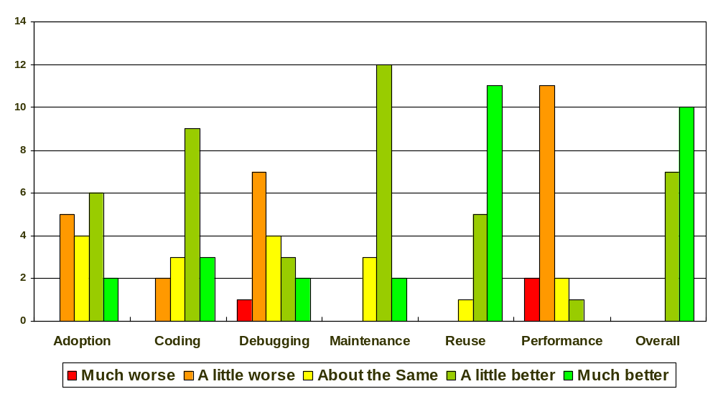
Post-Mortem Survey
Notes:
The survey indicates that the system was ultimately well received by programmers.
It goes without saying that these are all purely subjective perceptions. Save for wiping the team’s memories and developing the game again without components, there’s not way of knowing how it really compares to inheritance-based design.

Slide 25
Post-Mortem Comments
Data-driven creation was the biggest win
Prototyping is the biggest win once you have a library of behaviours
Modularity of behaviours was the biggest win
Data inheritance was the biggest win
Components are nothing new - no modern game could be built without them

Slide 26
Performance
GameObject::OnUpdate and OnMessage are easy targets
  For the critic
  For the optimiser
Existing optimisations:
  Message masks
  Update masks
  Logic state masks
  Time-slicing
  Attribute caching
  Leaving the back door open

Slide 27
Performance Lessons
Best optimisations are algorithmic:
  Avoid unnecessary messages, e.g.
    object->OnMessage(&message1);
    if (message1.x)
    object->OnMessage(&message2);
  Prefer attributes over messages
  Avoid unnecessary updates
Better instrumentation
Legalise the back door entrance
Notes:
Don’t be overzealous – allow last minute hacking

Slide 28
Future Improvements
Stateless behaviours
Submit batches of objects to stateless behaviours
  Better suited for parallel architectures
Message queuing

Slide 29
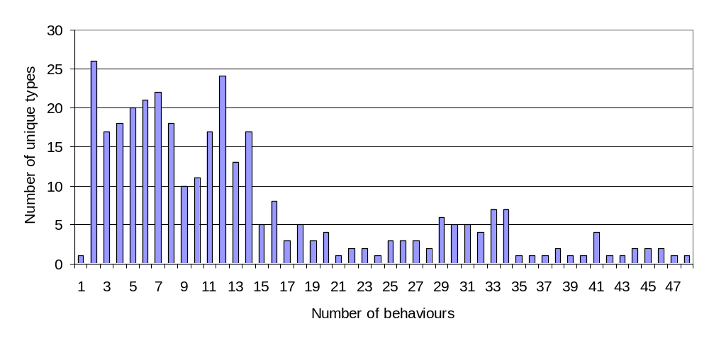
Prototype’s Data Types
1544 game object definitions
145 unique behaviours
335 unique data types
  156 unique prop types alone
Notes:
As part of the post-mortem research I also did some data mining of our game object definitions. I found 1544 definitions, of which 335 were unique. Between them, they used 145 different behaviours.
Is 335 game object types a lot? Our entire codebase contained 6400 classes (including the 145 behaviours)! However, we are looking at game objects, which represent one of the most active areas of game development, where most of the flux happens. Traditionally, in our previous games this area would be covered by only a handful of C++ classes. For props alone I found 156 different types, compared to just one in Hulk:UD.
This histogram shows only the numbers of types, not instances, with the given number of behaviours.
Measuring instances would require elaborate instrumentation of the game code.
The data includes types which may have not been used in game at all.

Slide 30
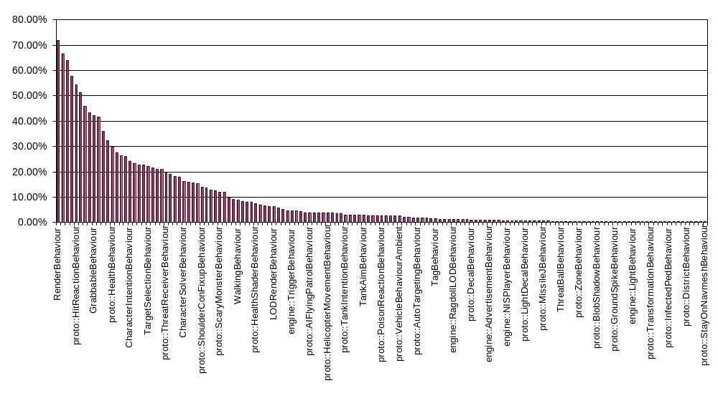
Behaviour Usage
Notes:
RenderBehaviour 240 71.6%
PhysicsBehaviour 223 66.6%
engine::AudioEmitterBehaviour 214 63.9%
engine::PlaybackTreeBehaviour 193 57.6%
proto::HitReactionBehaviour 182 54.3%
engine::PropLogicTreeBehaviour 172 51.3%
First thing to notice: no behaviour is used in every type. Top 6 behaviours are used in more than half of types. The rest are more or less custom. Roughly 2/3, or about 100 of all behaviours are very specialised (under 10% use).
Render and physics behaviours would have a much higher usage rate per number of instances.

Slide 31
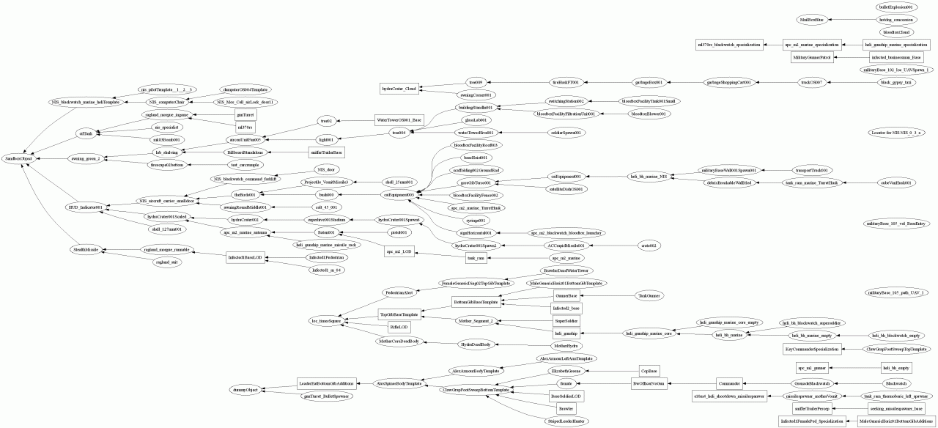
Implicit “Class Hierarchy”
Notes:
In order to further assess how behaviours are used to implement different types, one can attempt to reconstruct the implicit class hierarchy from subsets of behaviours used in each unique type. This is what I got by constraining the reconstruction algorithm to single-inheritance.
This is without the leaf nodes!
Interestingly, the algorithm found the same division as you would see in hand-made hierarchies: props vs characters. However, there are more than one independent character and prop trees.

Slide 32
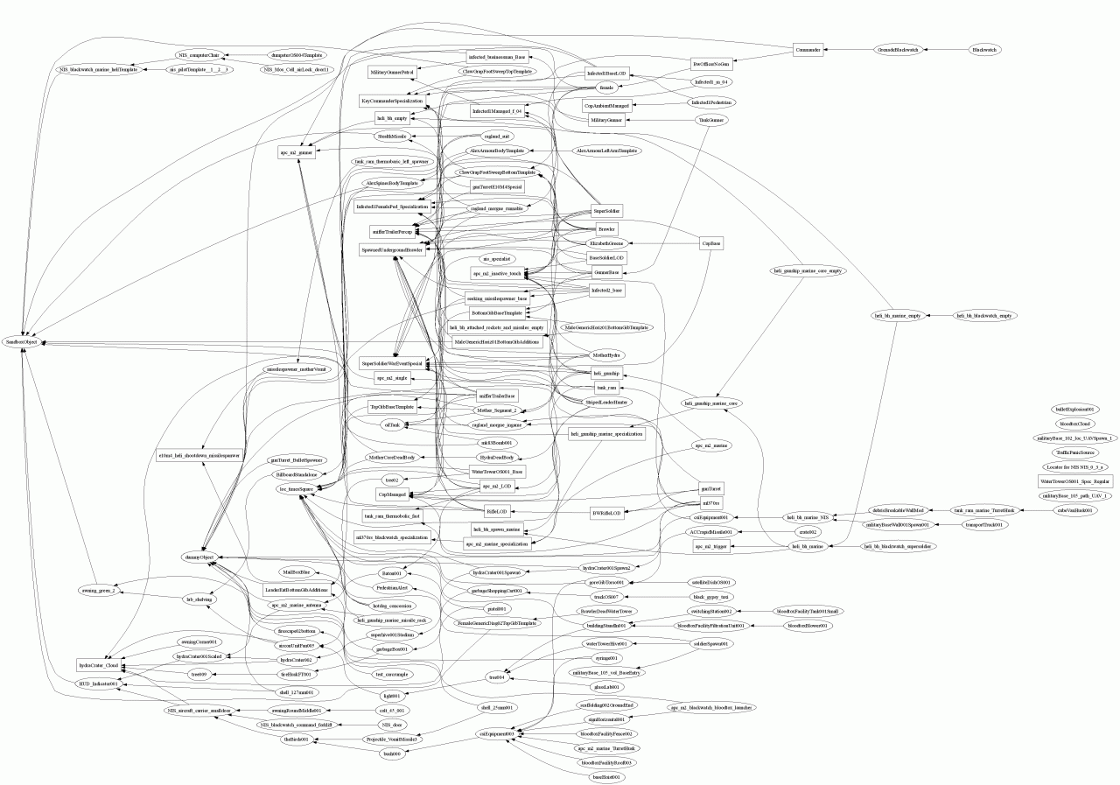
Implicit “Class Hierarchy”
Notes:
And this with multiple-inheritance allowed, again without the leaf nodes.
This hierarchy-recovering exercise was interesting for me because it brought about the idea that perhaps there is a way to bake this C++ class hierarchy back into source code to recover some of the performance lost by using components.

Slide 33
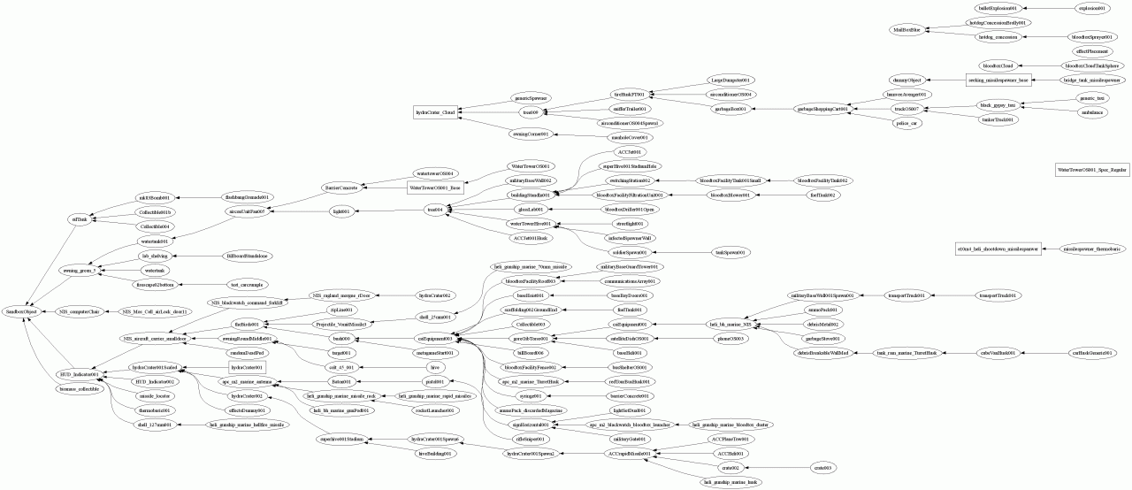
Prop Hierarchy
Notes:
The is the hierarchy of props alone, this time with leaves included (156). Compare it with the single CSPHulkPropInstance class from Hulk:UD.

Slide 34
Summary
Designs change
Class hierarchies don’t like change
Components do, but not without some sacrifices

Slide 35
Questions

